Slide 1

Sprocket Central Pty Ltd
Data analytics approach
Zhe Wang

Slide 2
Agenda
Introduction
Data Exploration
Model Development
Interpretation

Slide 3
Introduction
Goal: Identify and Recommend Top 1000 Customer to Target from Datasets
Outline of Problem
Sprocket Central is a medium size bikes & cycling accessories company.
Their marketing team is looking to boost their sales by analyzing provided datasets.
Our job is to use the 3 datasets provided to analyze and recommend 1000 customers that Sprocket Central should target to drive higher value for the company.
Contents of Data Analysis
“New” and “Old” Customer Age Distributions
Bike related purchases over the last 3 years by gender
Job industry distributions
Wealth segmentation by age category
Number of cars owned and not owned by state
RFM analysis and customer classification

Slide 4
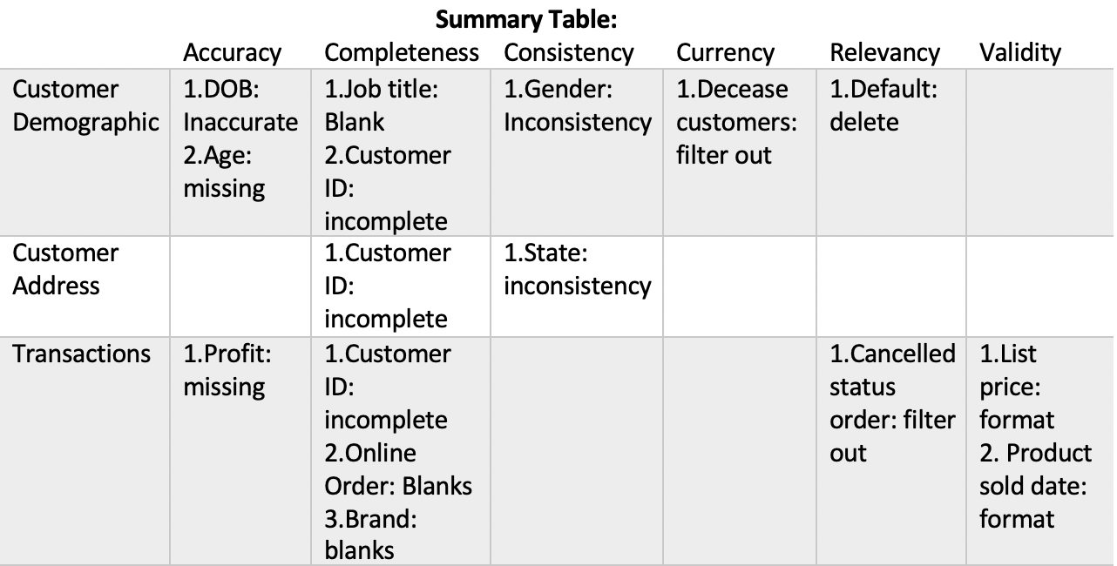
Data Exploration
Data Quality Assessment and ‘Clean Up’
Key Issues for Data Quality Assessment
Accuracy: Correct Values
Completeness: Data Fields with Values
Consistency: Values Free from Contradiction
Currency: Values up to Date
Relevancy: Data items with Values Meta-data
Validity: Data Containing Allowable Values
Uniqueness: Records that are Duplicated

Slide 5
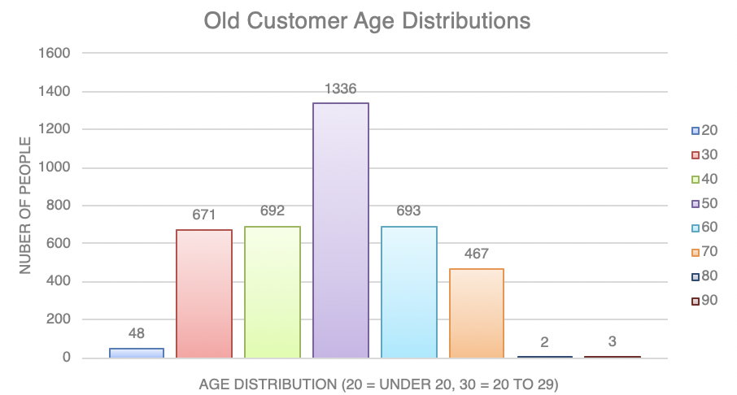
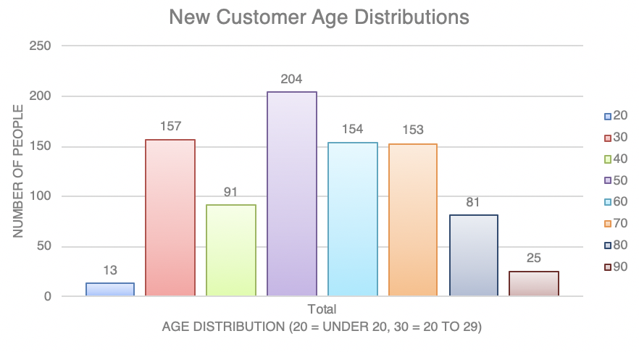
Data Exploration
‘New’ and ‘Old’ Customer Age Distributions
Most customers are aged between 40-49 in both ‘New’ and ‘Old’ Customer Age Distribution
The lowest age groups are under 20 and 80+ for both ‘New and ‘Old’ customer lists
The ‘New’ customer list suggests that age groups 20-29 and 40-69 are most populated
There is a steep drop of customers in the 30-39 age group in ‘New.’

Slide 6
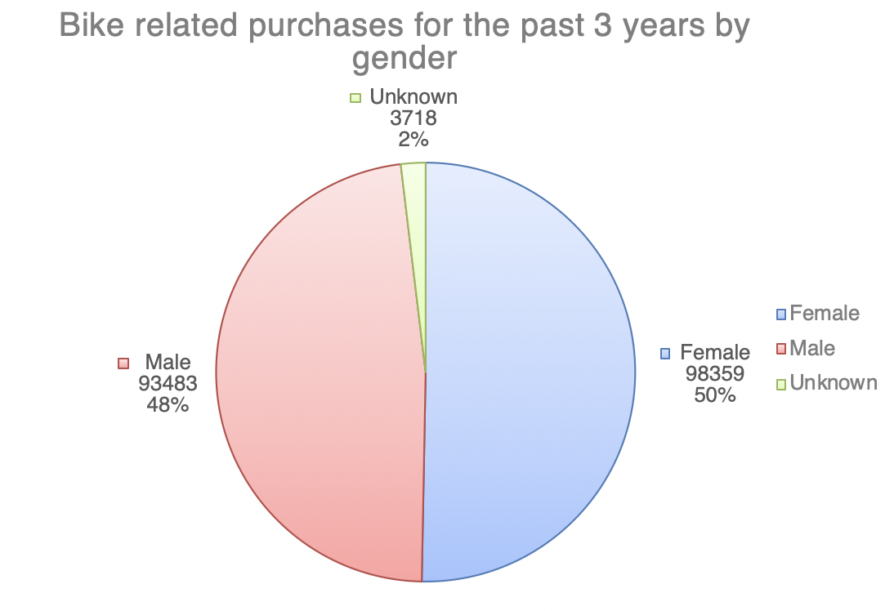
Data Exploration
Bike related purchases for the past 3 years by gender
Over the last three years, about 50% of bike related purchases were made by females; 48% were made by males; 2% were unknown.
Numerically, females purchases almost 5000 more than males
Females make up majority of bike related sales

Slide 7
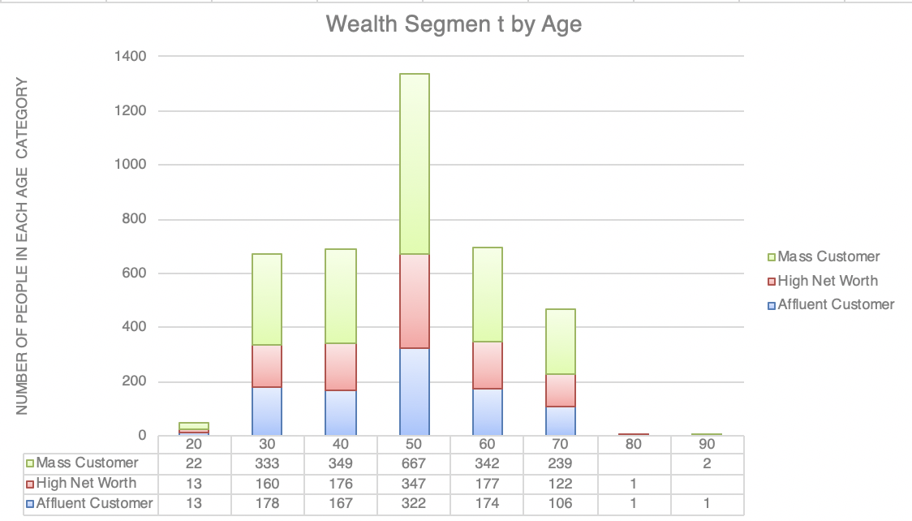
Data Exploration
Wealth Segmentation by age category
In all age categories the largest number of customers are classified as ‘Mass Customer’
The next category is the ‘High Net Worth’ customers.
The ‘Affluent Customer’ approximately equal to the ‘High Net Worth’ Customer except 40-49 age group

Slide 8
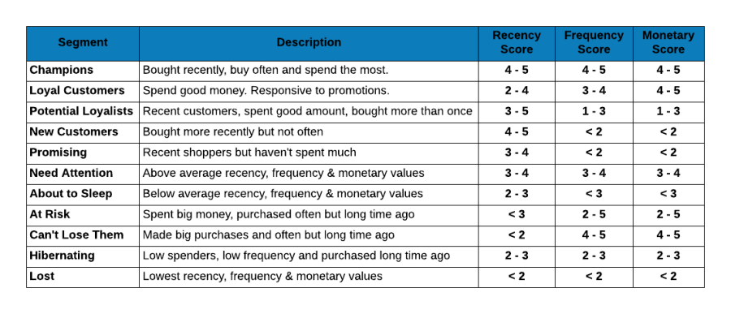
Model Development
RFM Analysis and Customer Classification
RFM analysis is used to determine which customers a business should target to increase its revenue and value

Slide 9
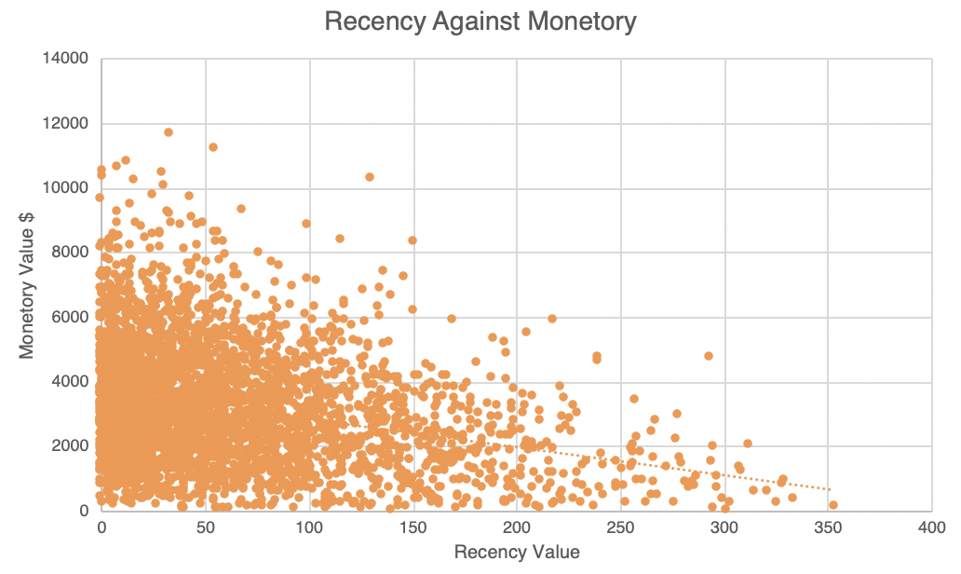
Model Development
Scatter-Plot based off RFM Analysis
The chart shows that customers who purchased more recently have generated more revenue than customer who visited a while ago.
Customers from recent past (50-100 days) also show to generate a moderate amount of revenue
Those who visited more than 200 days ago generate low revenue
Correlation Coefficient: -0.28

Slide 10
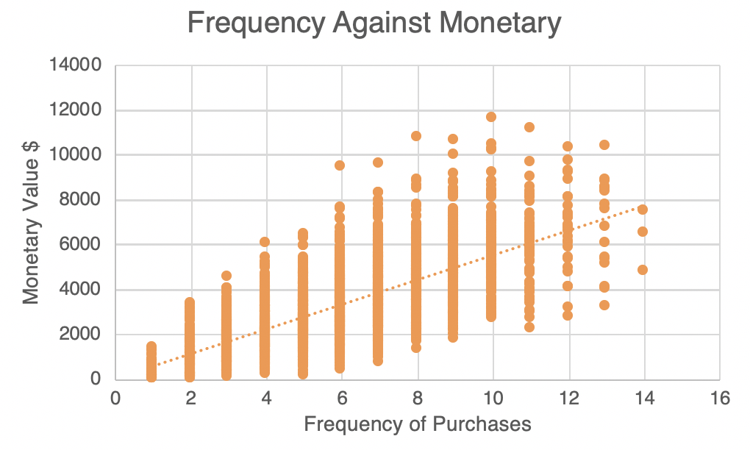
Model Development
Scatter-Plot based off RFM Analysis
Customer classified as “Platinum Customer,” “Very Loyal,” and “Becoming Loyal” visit frequently, which correlated with increased revenue for the business.
Naturally, there is a positive relationship between frequency and monetary gain for the business.
Correlation Coefficient: 0.72

Slide 11
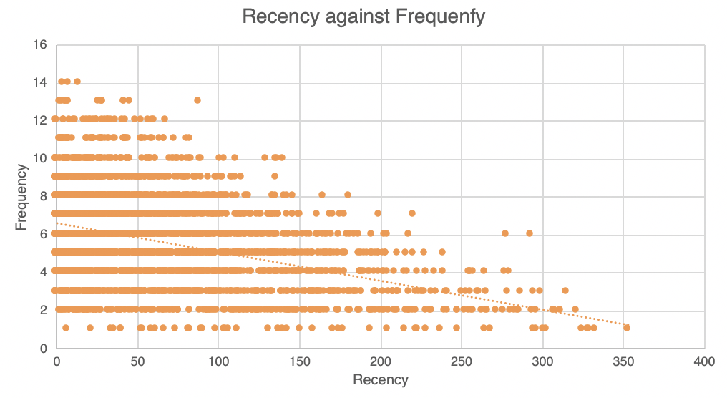
Model Development
Scatter-Plot based off RFM Analysis
Very low frequency of 0-2 correlated with high recency values. i.e. More than 250 days ago.
Customers that have visited more recently (0-50 days) have a higher chance of visiting more frequently(6+).
Higher frequency has a negative relationship with recency values. Such that very recent customers are also frequent customers.
Correlation Coefficient: -0.38

Slide 12
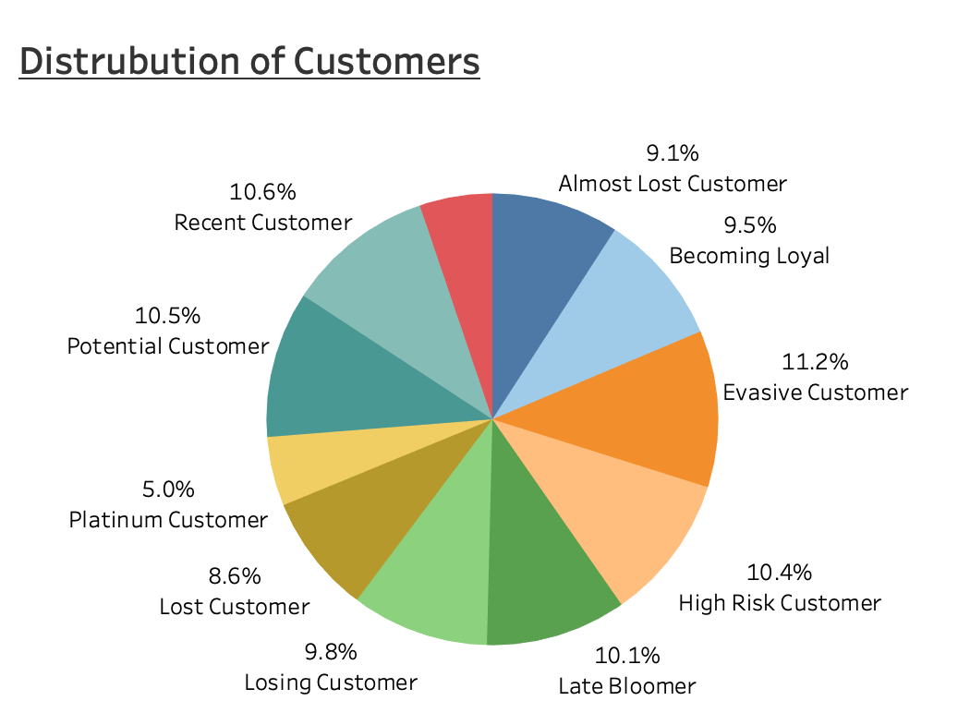
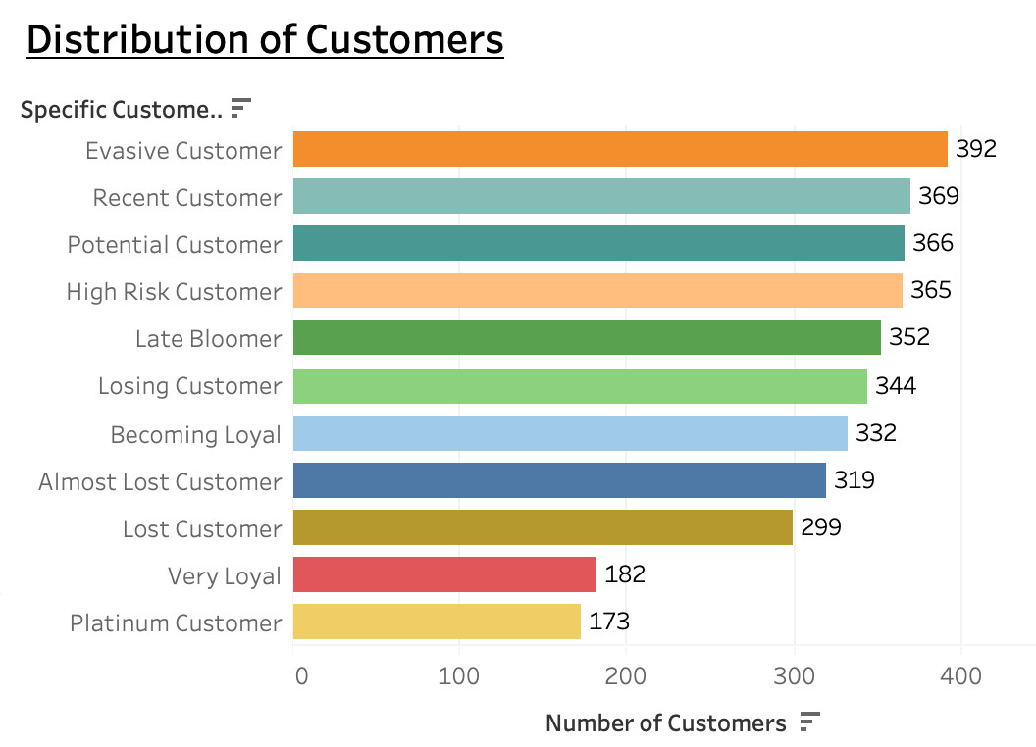
Customer Title Distributions in Dataset

Slide 13
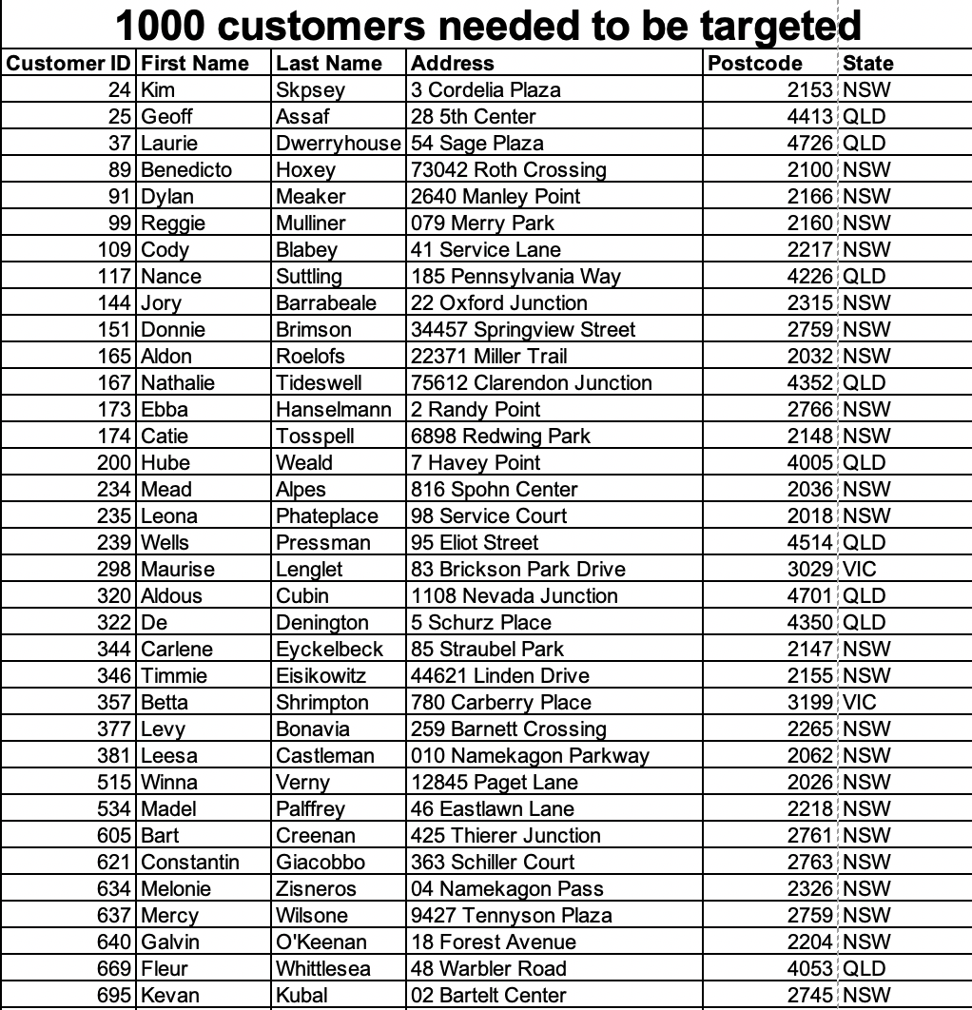
Interpretation
Preview of the Top 1000 Customers to Target

Slide 14
Thank you for watching!

